Slide 1
Final Project Presentation
EECE 2140 – Frank Anderson

Slide 2
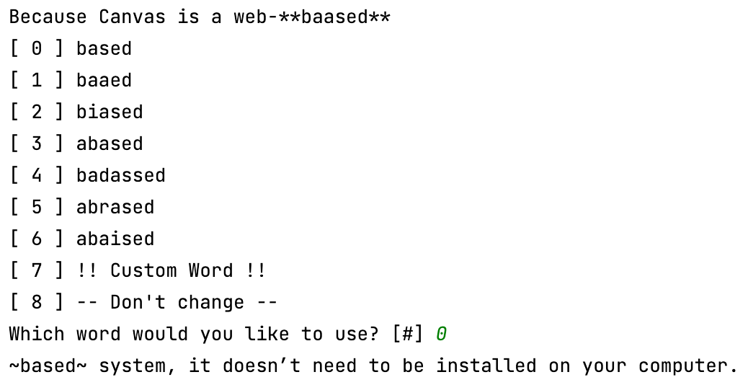
Overview & Main Features
Spell Checker application
Reads .txt file and finds spelling errors
Asks user to choose from a list of suggestions or use their own word
Writes changes to new .txt file.

Slide 3
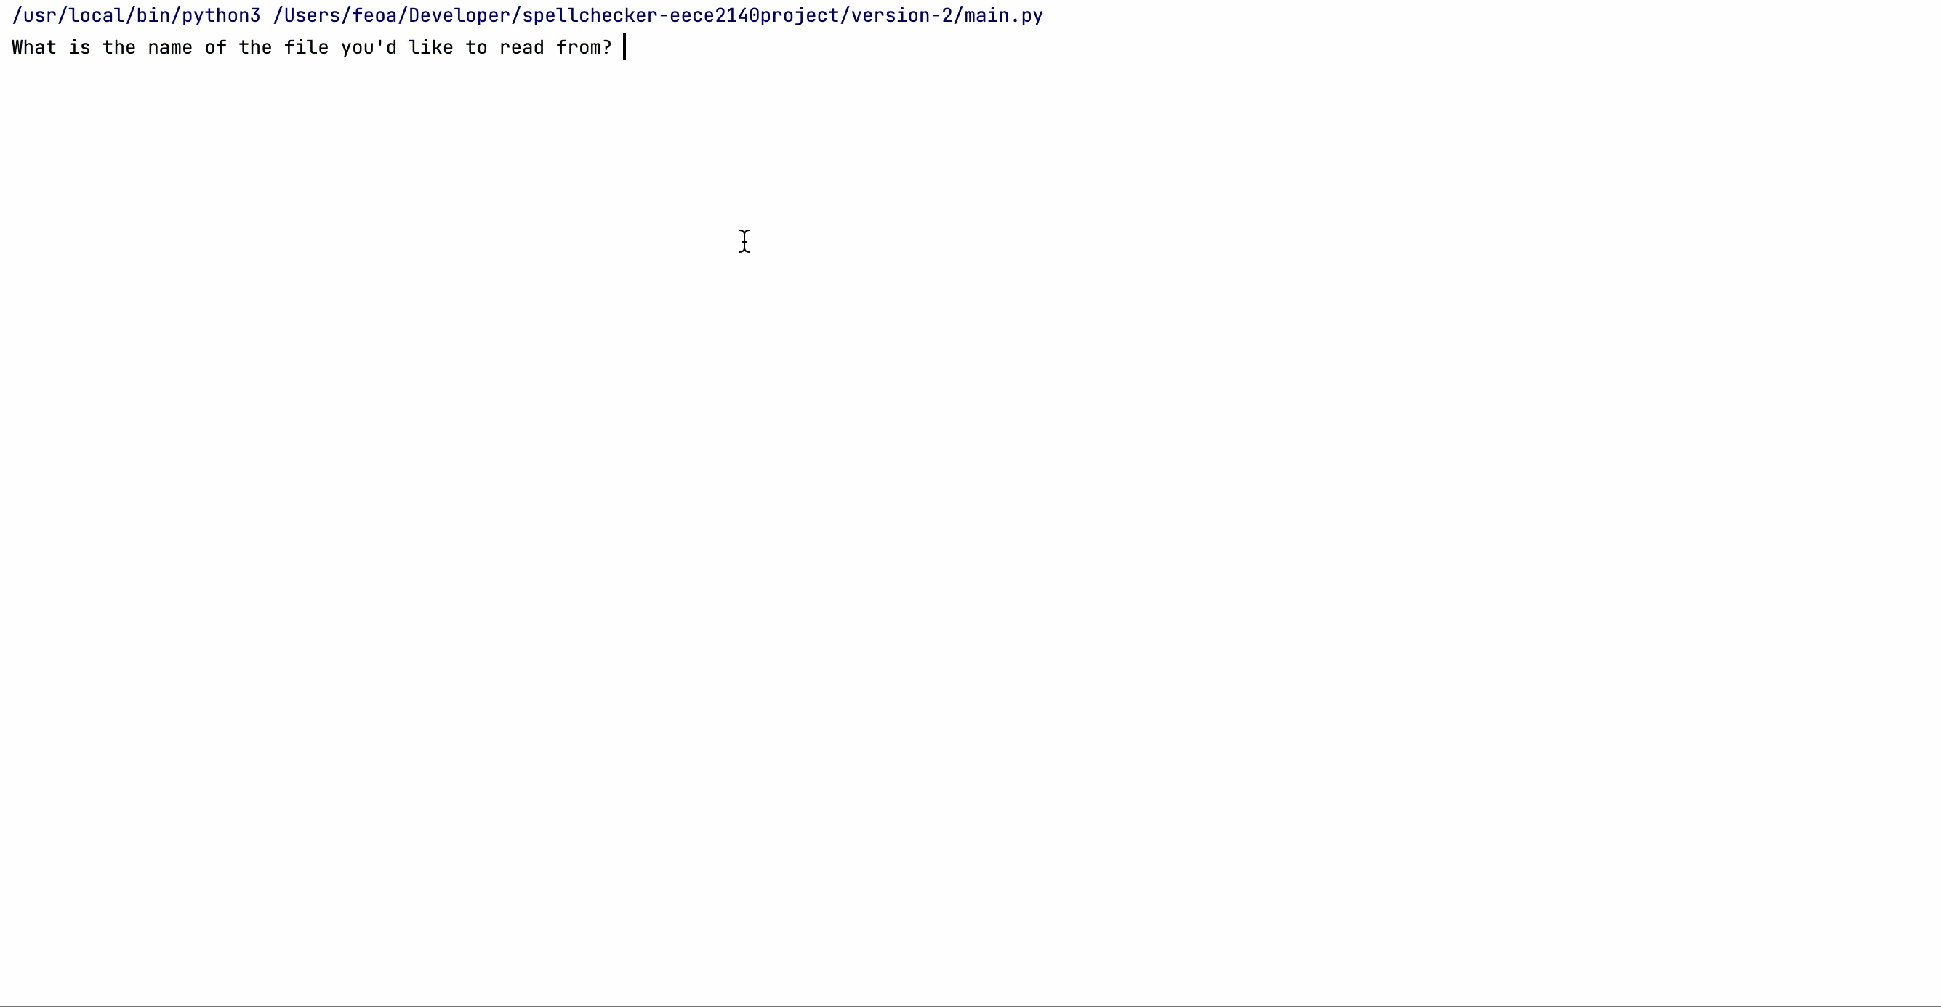
Demo

Slide 4
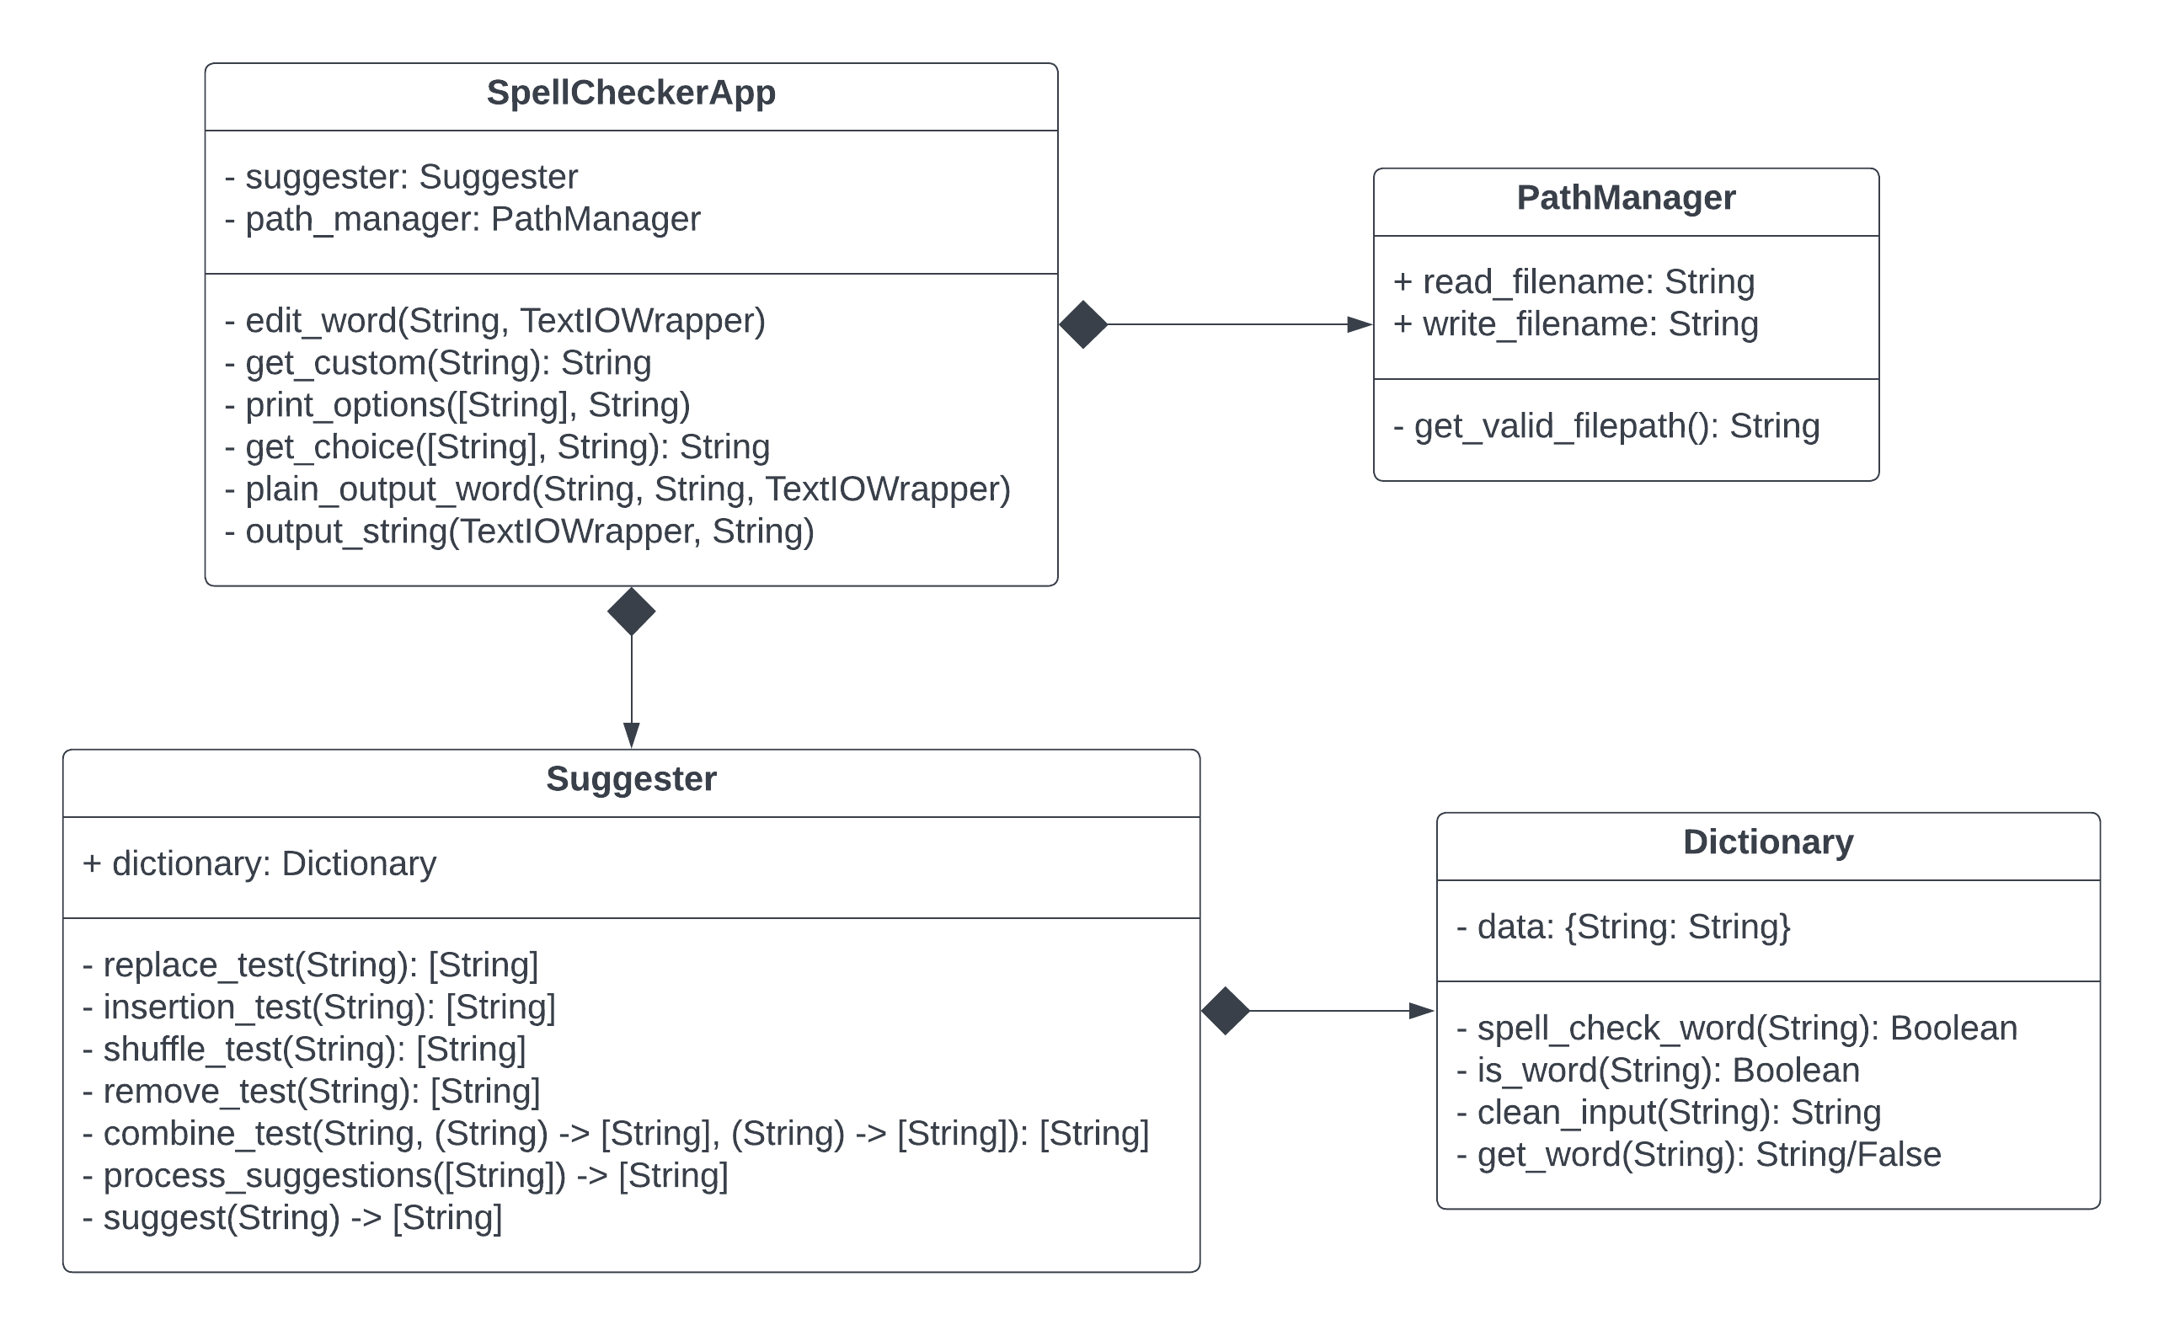
Code Walkthrough

Slide 5
Generating Options
Replace: replace each letter with a→z
creade → … treade, cteade, crtade, cretde, create, creadt …
Insert: insert at each index a→z
awrd → ... aawrd, aawrd, award, awrad, awrda …
Shuffle: swap each adjacent set of letters
readre → eradre, raedre, redare, rearde, reader
Remove: remove each letter
hii → ii, hi, hi
Combine: runs one test and then another on the result of the first.
After generating options, test each one and return only those which are valid words.
Simple changes are tested first, so return only the first 7 valid results because they are the most similar to the original word.

Slide 6
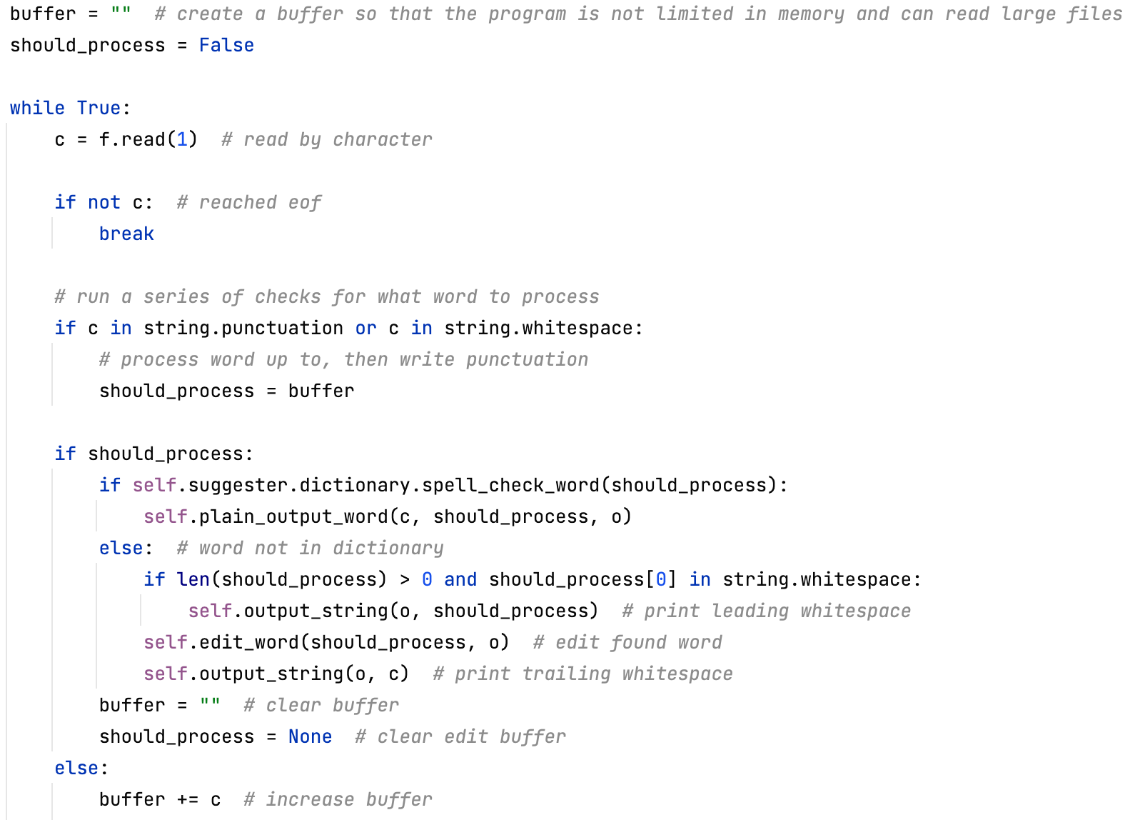
Iterating over the file
Use a buffer, storing only up to the most recent word.
If the current character is punctuation or whitespace, run analysis on the buffer.
Otherwise, increase the buffer.

Slide 7
Thank you.

